Slide 1

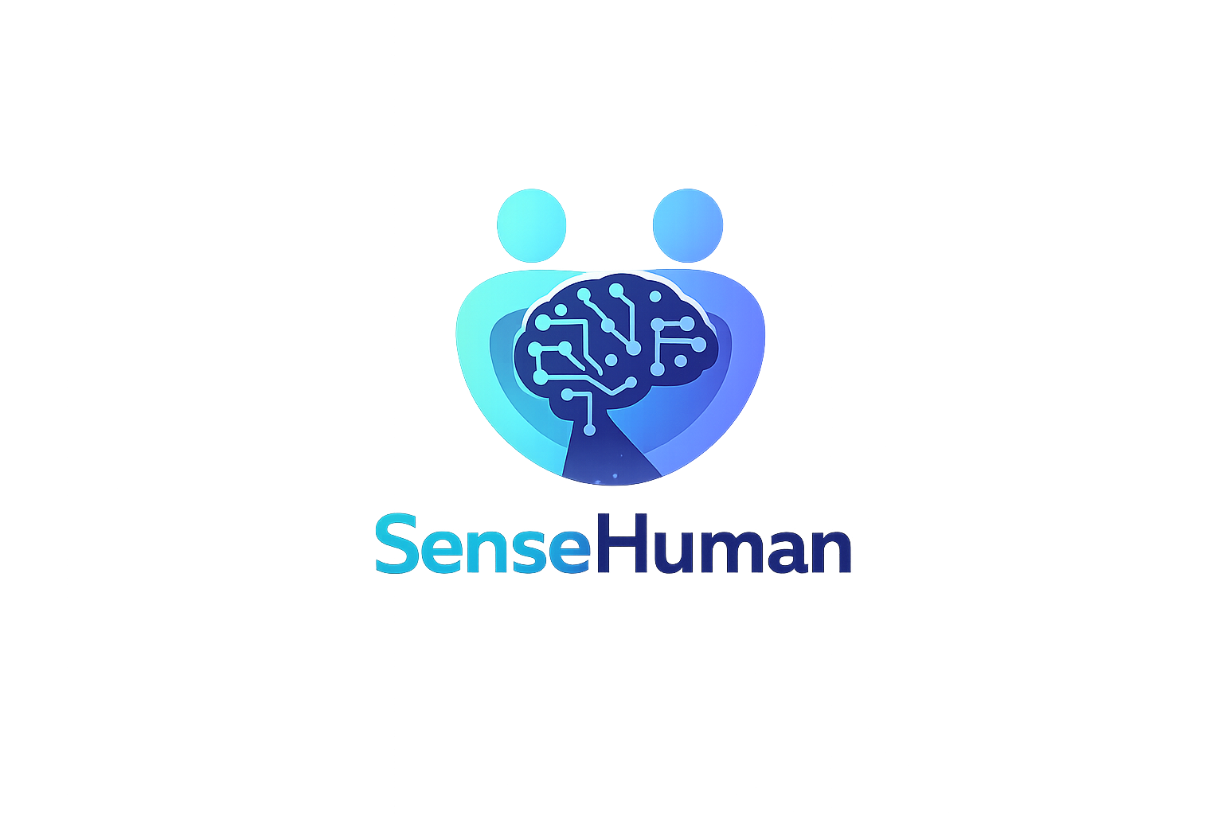
Notes:
Hello, we will present our project, which we call SenseHuman.

Slide 2
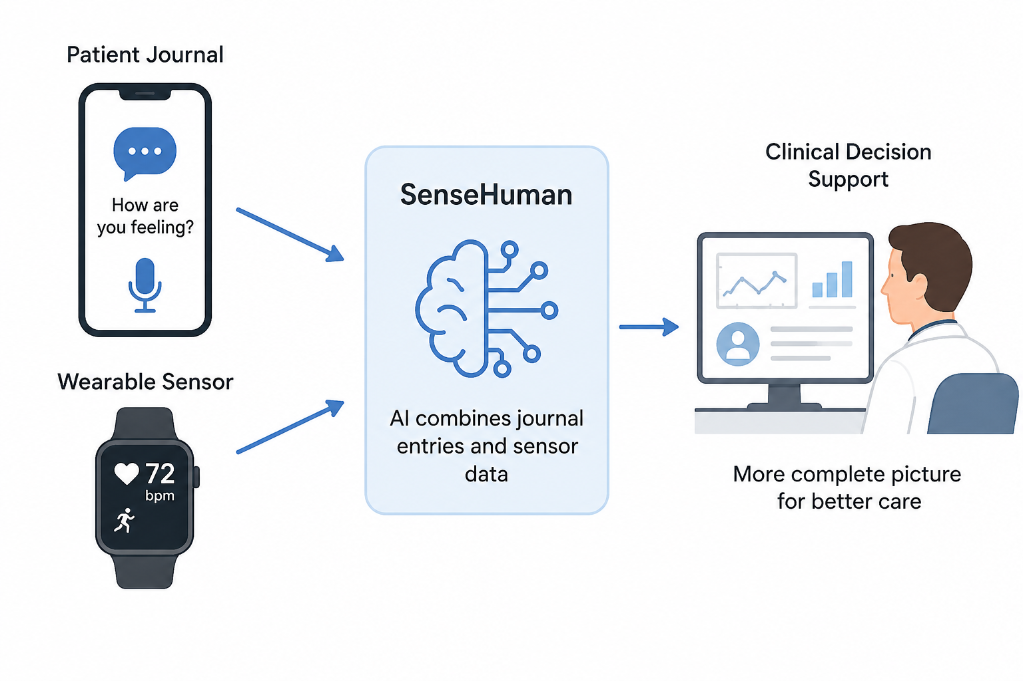
SenseHuman is an AI-based clinical diary that combines patient journal entries with wearable sensor data to support better clinical decision-making.

Slide 3
METHOD
Four stages
Stage 1: Semi-structured interviews
  Understand user needs, expectations, and concerns.
Stage 2: Participatory design
  Let patients and healthcare professionals help shape the system design.
Stage 3: Three-week home study
  Test a prototype in everyday life to see how it fits into daily routines.
Stage 4: Post-use study
  Evaluate usefulness, ease of use, and overall user experience.
Notes:
The first stage is semi-structured interviews, where we speak with patients and healthcare professionals to understand their needs, expectations, and concerns.
The second stage is participatory design workshops, where users would help shape how the system should work in practice.
The third stage is a three-week home study, where participants would use a prototype in their everyday lives to see how it fits into daily routines.
The final stage is a post-use survey, where we would collect structured feedback about usefulness, ease of use, trust, and overall experience.

Slide 4
Main focus
Semi-structured interviews
Due to course scope...
  No opportunity to fully design, prototype, and test SenseHuman
Aim
  identify user needs and barriers early in the design process
Interview targets:
  Patients with recurring symptoms or regular monitoring (e.g., glucose, heart rate, ...)
  Healthcare professionals who use patient-generated data
Notes:
However, given the scope of this course, and since we do not have the opportunity to fully design, prototype, and test SenseHuman, we will mainly focus on the first stage: semi-structured interviews.
This stage helps us identify user needs and potential barriers early in the design process, which gives us a realistic foundation for discussing how SenseHuman could be designed to become meaningful, trustworthy, and useful in healthcare.
Our interview targets are patients whose health requires regular monitoring, such as glucose, heart rate, activity, or symptom tracking, and healthcare professionals who may use this data in clinical decision-making.

